Slide 1
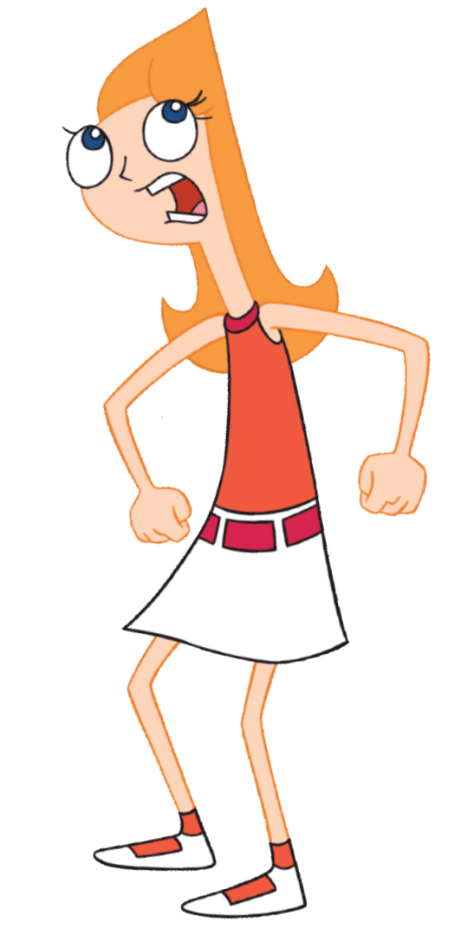
MOM! Phineas and Ferb are ...
Aims: To understand the use of random numbers in Scratch.
Objectives:
ALL: Copy a script that uses random numbers.
MOST: Use random numbers in a simple game.
SOME: Design a new game that uses a random
numbers.

Slide 2

Computers use a mathematical formula to generate pseudo-random numbers.
These are good enough for most purposes, but if you REALLY need random numbers, you can get them from:
http://www.random.org/
Here's a really simple script that simulates the roll of a die:
Have a play with the “pick random” command.

Slide 3
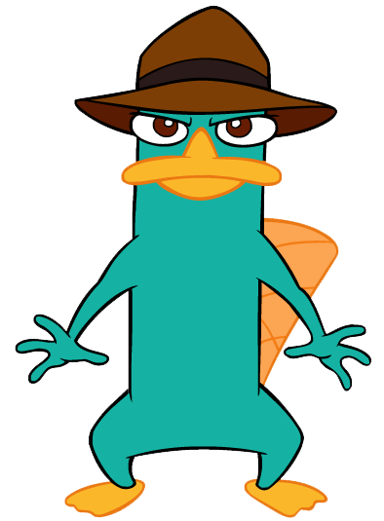
Task:
Imagine someone asked you to write a program to help them choose national lottery numbers.
You could use the “pick random” command to choose the numbers:
How many numbers do you need?
What are the upper and lower limits of the numbers?
Are duplicates allowed?
If you get stuck, a possible solution is on the next slide.

Slide 4
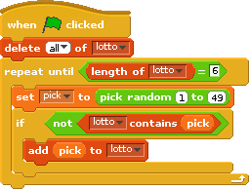
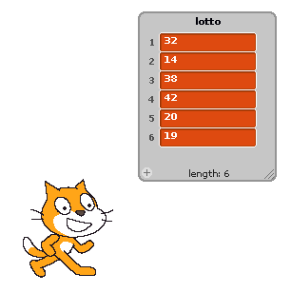
You need to make a list called “lotto”.
We need to empty it before running the script.
The loop runs until we have 6 numbers.
We set “pick” to a random number between 1 and 49.
If “lotto” does not contain “pick”, we add it to the list.

Slide 5
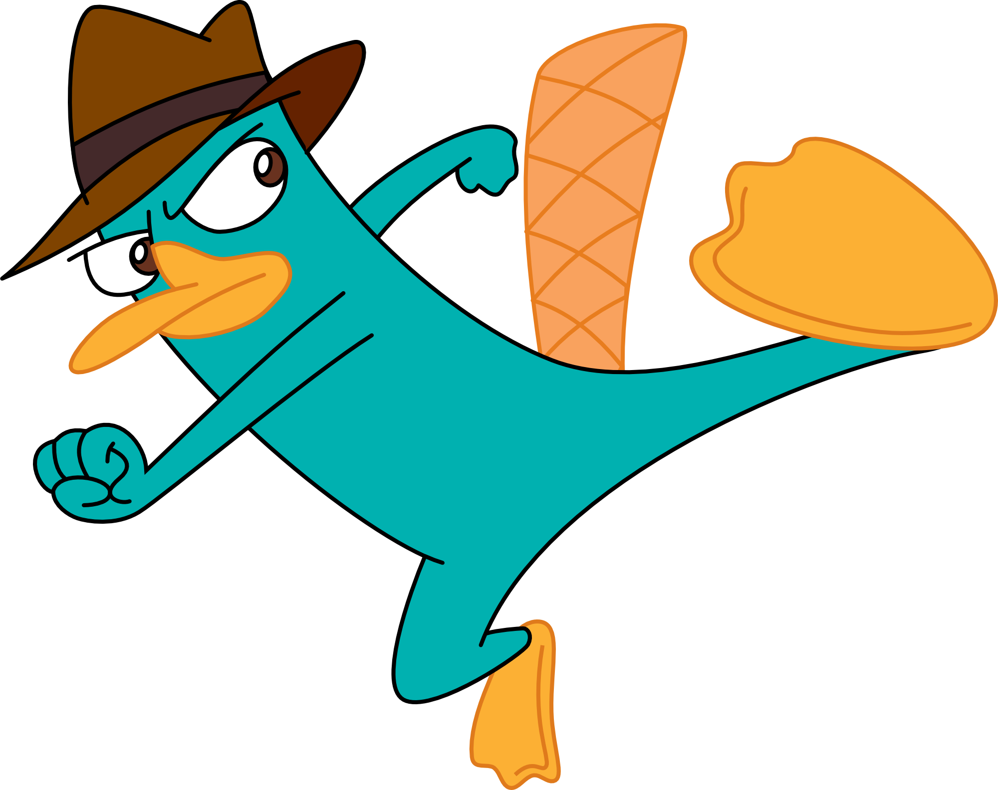
Next we are going to make a script which performs a very simple test of how random the “pick random” numbers are.
Here's the instructions:
Make a list with 10 items.
Use a loop to pick a random number from 1 to 10 one thousand times.
If a number comes up, add one to the element in the list at that index.
At the end, all the cells should be somewhere around 100.
Have a go, a possible solution is on the next slide (but you don't need to look at that!)

Slide 6
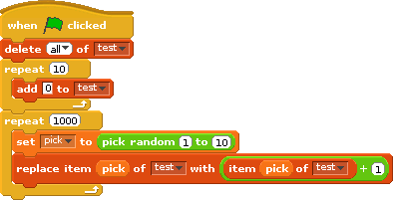
Here we simply replace the item at index “pick” in the list with itself plus one.

